Slide 1
Examining Employee Attrition at IBM
Akash Navneeth, Akshat Gadiya, & Rohith Thadela

Slide 2
Project Overview & Dataset Description
Dataset: Employee Attrition at IBM
What is employee attrition?
What does our analysis hope to achieve?

Slide 3
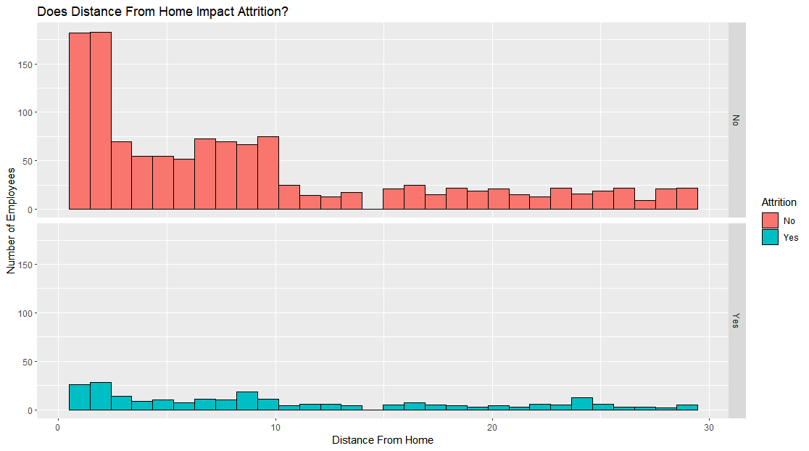
Insight 1
Distance from Home does not contribute to the attrition rate.
The number of employees who left the company based on this factor is too few.

Slide 4
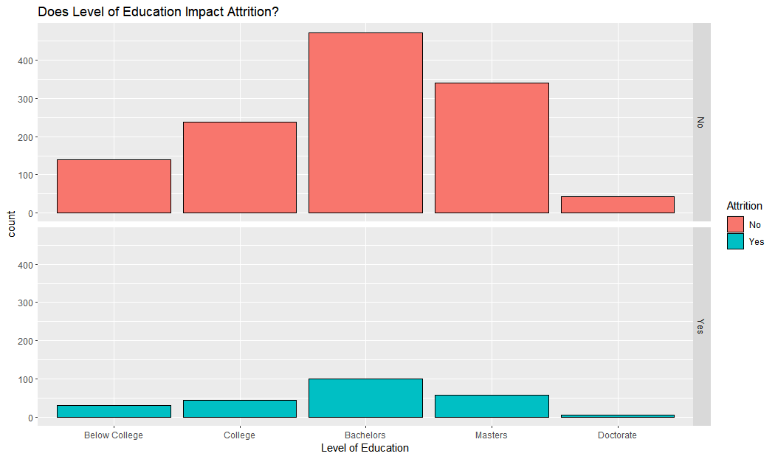
Insight 2
Employees with Bachelor’s Degrees are leaving the company more so than others.

Slide 5
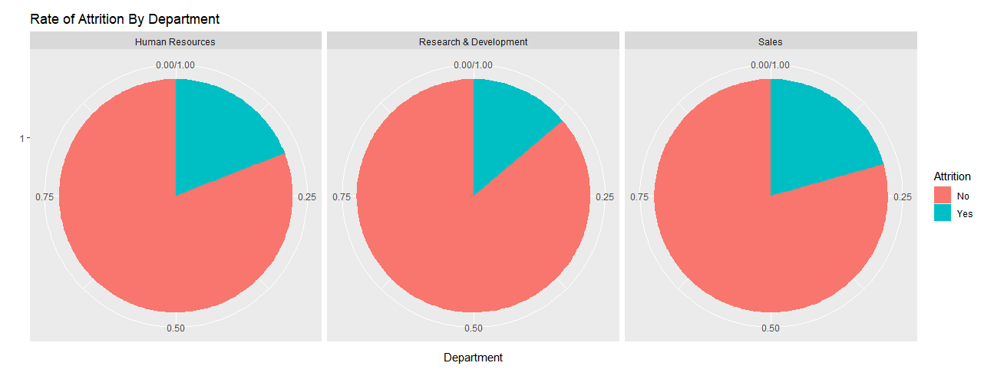
Insight 3
Employees in the Research & Development are leaving the company are leaving the company at a lower rate.

Slide 6
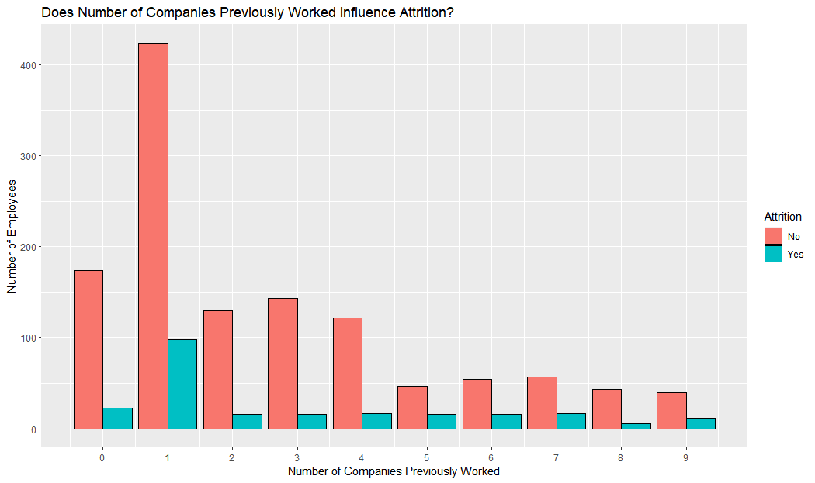
Insight 4
Employees who worked at 0 or 1 companies before IBM are of a higher count of leaving the company
Reflects on Education Level reasoning

Slide 7
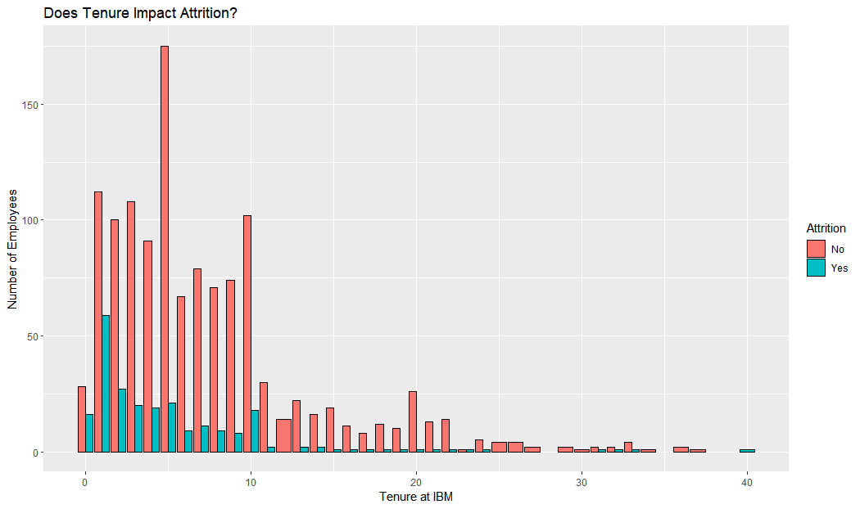
Insight 5
Employees who have worked with the company between 0 and 10 years are of a higher count to leave the company
Reflects on the Education Level reasoning

Slide 8
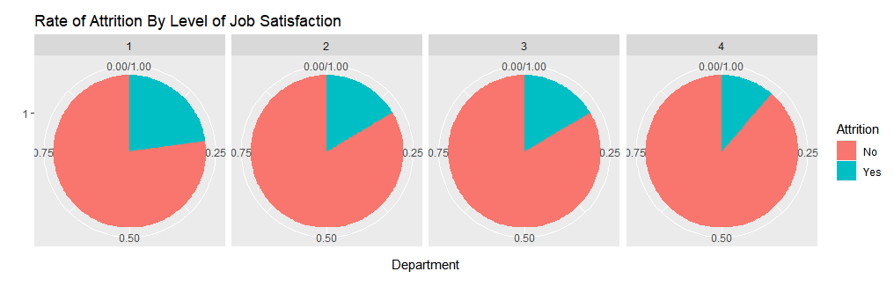
Insight 6A
Employees with lower levels of job satisfaction, are more likely to leave the company
Notes:
The satisfaction levels range from Level 1, indicating the lowest level of satisfaction where employees are dissatisfied with their job, to Level 4, representing very high satisfaction. The visualization shows that job satisfaction plays a significant role in employee retention. Specifically, employees who report higher levels of job satisfaction are more likely to remain employed with the company

Slide 9
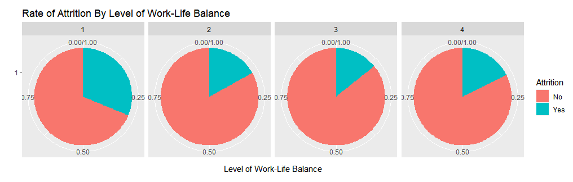
Insight 6B
Employees with lower ratings of work-life balance are more likely to leave the company
Employees rating work-life balance with 4 may have left the company because of external factors
Notes:
If you look at the first pie chart you can see that attrition rate is over 25% for people with poor work life balance. This means that this has a significant factor on employee attrition rate.
However as you move along the charts to higher balance. You can see that atrition stays the same. Go up. Even though they have good work like balance they might not have had high job satisfaction as showed in the previous slide.

Slide 10
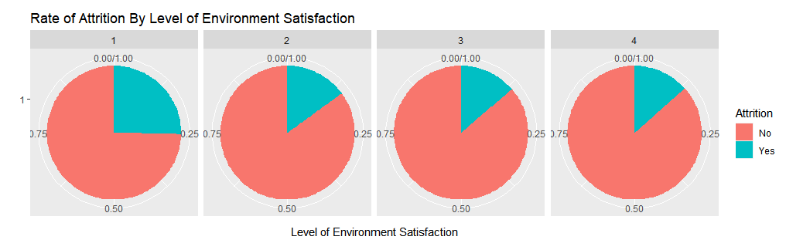
Insight 6C
Employees with lower levels of environment satisfaction, are more likely to leave the company

Slide 11
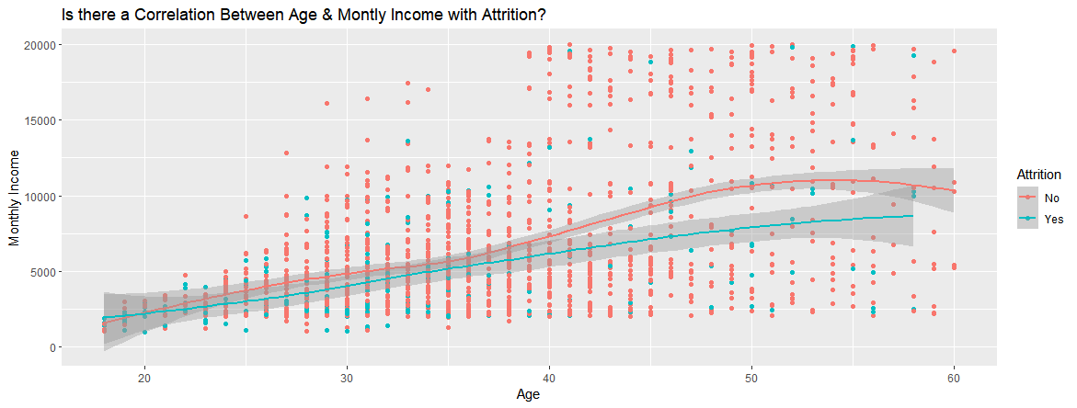
Insight 7
Employees who stay with the company experience a slight increase in income and age, followed by a parabolic increase and decline in income as they age.
Those who leave tend to have a gradual income increase with age. A few possibly reasons to leave could be due to job dissatisfaction, ageism, or desire for work-life balance.

Slide 12
Conclusion
The implications of the analysis is as follows:
HR uses a classification model to evaluate potential hires
Classification model has an accuracy of 81.02%
Allows evaluation of what employees wish IBM offered
Changing benefits package for employees
Changing work style to accommodate employees’ needs

