Slide 1
SEM of Air France
By:
mansi patel, neel patel, & akash navneeth

Slide 2
Introduction
Overview of Air France
The Need of Search Engine Marketing Strategies
Goals of Our Project:
Identifying the Best Campaign (& Campaign Characteristics)
Identifying the Best Publisher

Slide 3
Method
Performance Metrics:
Click-Through Rate (CTR)
Transaction Conversion Rate (TCR)
Cost Per Click (CPC)
Return On Ad (ROA)
Pay Per Click (PPC)

Slide 4
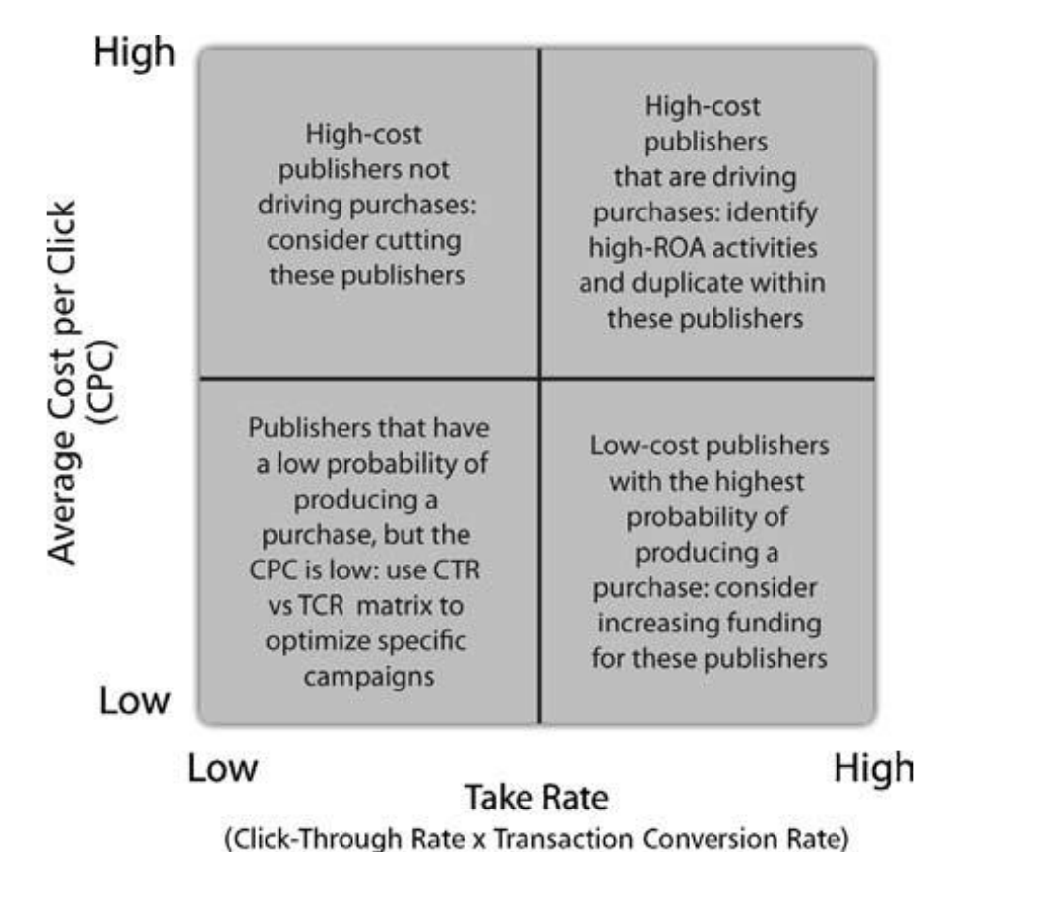
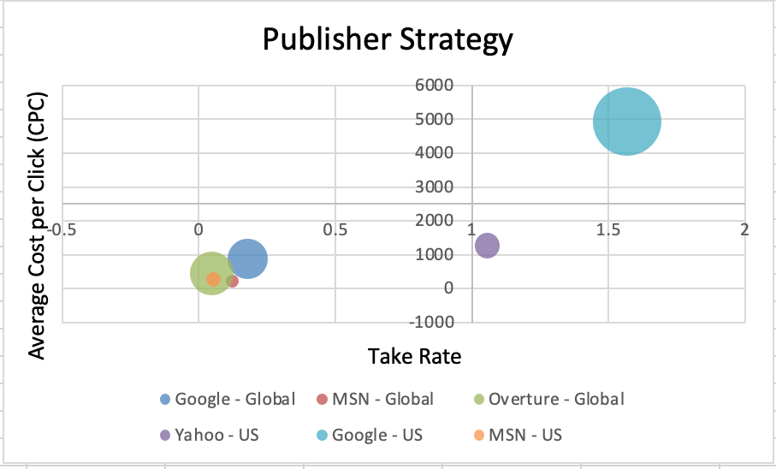
Method
Publisher Strategy:

Slide 5
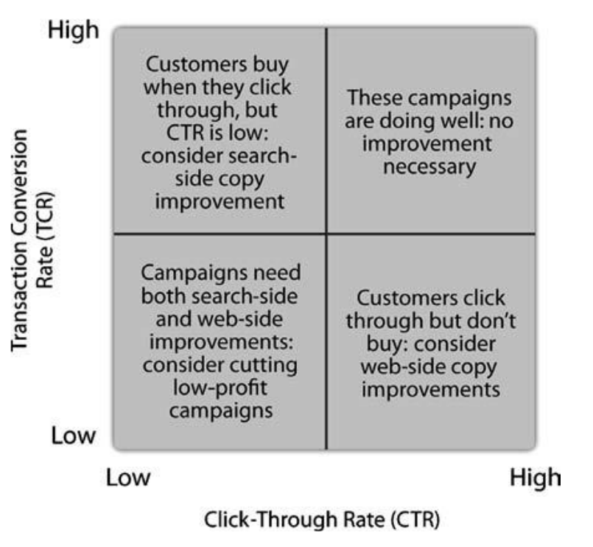
Method
Campaign Strategy:

Slide 6
Method/Result
Row Labels | Sum of Avg. Pos. | Count of Bid Strategy | Sum of Avg. Cost per Click | Sum of Amount | Sum of Total Cost | Count of Keyword
(blank)
Western Europe Destinations | 1113.466867 | 395 | 696.0709072 | 42103.9 | 36182.3624 | 395
Unassigned | 2717.66574 | 1214 | 949.9831316 | 777517.95 | 206271.9366 | 1214
Paris & France Terms | 222.6765875 | 169 | 395.1316477 | 136393.55 | 102597.3747 | 169
Outside Western Europe | 18.78651608 | 14 | 41.81411968 | 0 | 597.8374992 | 14
Google_Yearlong 2006 | 944.1801045 | 520 | 1236.818673 | 22373.7 | 81959.48732 | 520
Geo Targeted Seattle | 56.3264233 | 35 | 81.44562914 | 2817.75 | 1174.249997 | 35
Geo Targeted San Francisco | 203.0677416 | 125 | 322.7422207 | 3822.45 | 2089.412496 | 125
Geo Targeted Philadelphia | 146.1585903 | 92 | 244.8045653 | 434.35 | 745.9749995 | 92
Geo Targeted New York | 468.7051547 | 288 | 736.1972341 | 35580.15 | 9539.674983 | 288
Geo Targeted Miami | 105.6051251 | 52 | 119.5400639 | 470.05 | 638.5249989 | 52
Geo Targeted Los Angeles | 289.2438413 | 155 | 394.8748728 | 2183.65 | 1799.987497 | 155
Geo Targeted Houston | 199.1230664 | 116 | 320.2655513 | 7065.2 | 1992.787497 | 116
Geo Targeted Detroit | 208.5182802 | 105 | 253.6512084 | 923.95 | 719.0249995 | 105
Geo Targeted DC | 247.1277239 | 147 | 354.0422248 | 12395.55 | 1271.362499 | 147
Geo Targeted Cincinnati | 25.20014739 | 9 | 20.18375 | 0 | 33.75 | 9
Geo Targeted Chicago | 156.5633234 | 95 | 199.7106477 | 7144.25 | 1581.674997 | 95
Geo Targeted Boston | 280.005566 | 146 | 347.2665054 | 2878.95 | 1396.174999 | 146
Geo Targeted Atlanta | 74.17985919 | 37 | 69.83448449 | 170 | 265.2499998 | 37
General Terms | 3.570413103 | 1 | 1.17080115 | 1977.95 | 606.4749957 | 1
French Destinations | 128.3023765 | 105 | 197.9502368 | 6223.7 | 8431.737481 | 105
Business Class | 60.8417818 | 31 | 124.6501445 | 144.5 | 3269.049996 | 31
Air France Global Campaign | 433.9129177 | 282 | 616.4361132 | 467981.95 | 62059.44977 | 282
Air France Branded | 93.11442486 | 73 | 67.10712385 | 2349870.9 | 143077.8242 | 73
Air France Brand & French Destinations | 506.3325772 | 304 | 733.2886473 | 797029.7 | 87014.53705 | 304
Grand Total | 8702.67515 | 4510 | 8524.980504 | 4677504.1 | 755315.922 | 4510

Slide 7
Results
KPI Impact:
KPI of all publisher:
KPI of Kayak:
Publisher Name | Average of Avg. Cost per Click | Sum of Total Cost | Sum of Take Rate | Sum of Amount | ROA | KPI
Google - Global | 2.224959422 | 120946.712 | 0.179334281 | 929549.8 | 7.68561447 | 17.1001803
Google - US | 2.383941762 | 353640.5989 | 1.568592617 | 1745481.8 | 4.9357506 | 11.766542
MSN - Global | 2.152998203 | 12160.36244 | 0.124223657 | 145524.25 | 11.9670981 | 25.7651407
MSN - US | 2.867470078 | 16098.48741 | 0.053505532 | 181549.8 | 11.2774446 | 32.337735
Overture - Global | 0.804758848 | 64295.86214 | 0.047680576 | 430084.7 | 6.68915052 | 5.38315307
Overture - US | 0.763920558 | 141976.0745 | 0.042853332 | 347433.25 | 2.44712534 | 1.86940936
Yahoo - US | 1.998875657 | 46197.82462 | 1.054890612 | 882288.95 | 19.0980627 | 38.1746526
Grand Total | 1.89023958 | 755315.922 | 3.071080607 | 4661912.55 | 6.17213594 | 11.6668157
Kayak
ROA = | 64.51311
CPC = | 1.25648
KPI = | 81.05913

Slide 8
Conclusion
Key Takeaways from Our Analysis:
Increase budget for Yahoo-US
Promote Western European Destinations
Boost conversions and generate revenue

Slide 9
THANK YOU!!

